Slide 1

Changes I have made for local analysis
Separating Francis’ “Control” and Katie’s “T1”

Slide 2
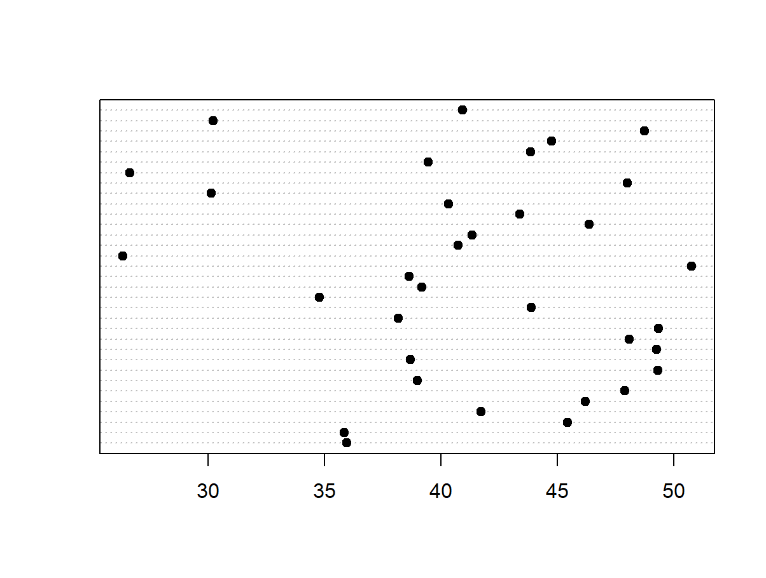
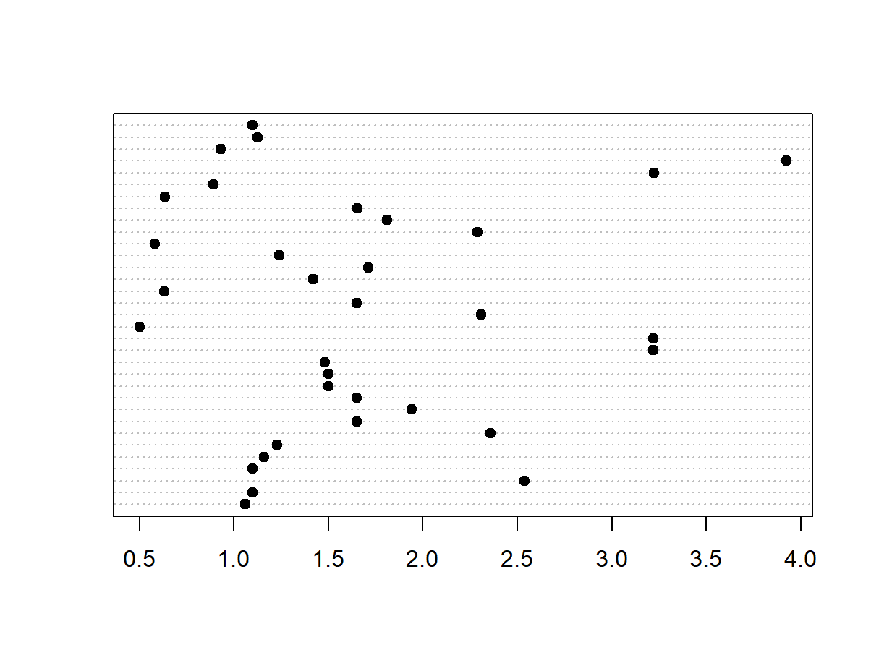
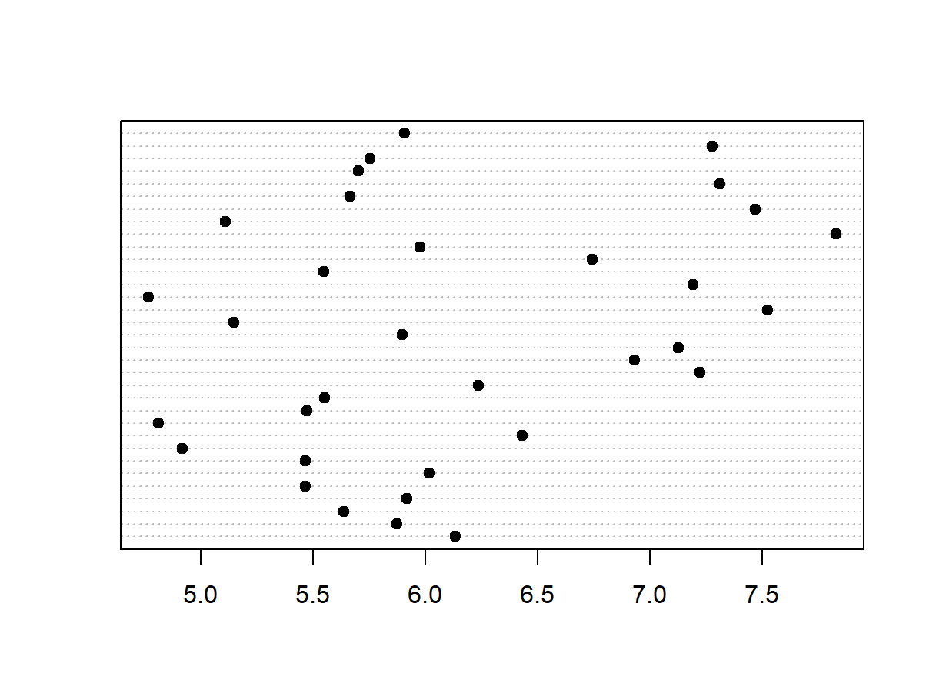
Relationships among landscape vars dotchart(land$#var#, pch = 19)
ENN
LPI
I think it’s fine still?

Slide 3
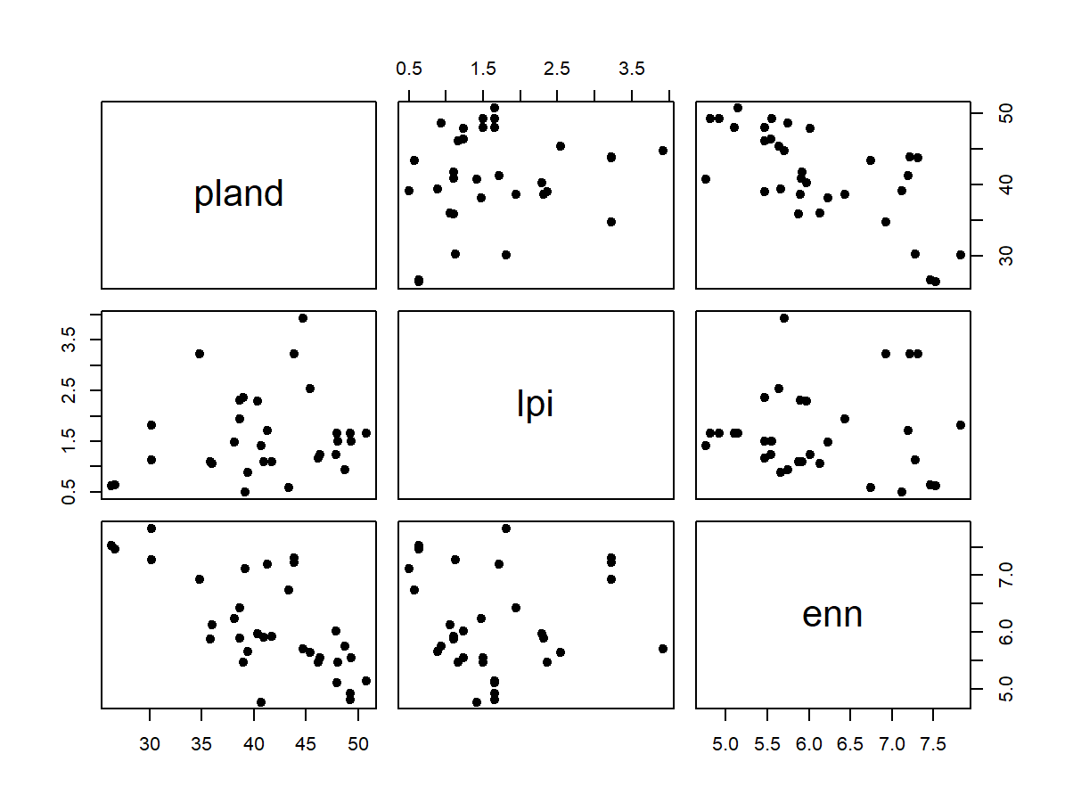
pland lpi enn
pland 1.0000000 0.1819472462 -0.6958556927
lpi 0.1819472 1.0000000000 0.0008583432
enn -0.6958557 0.0008583432 1.0000000000
plot(land[2:4], pch = 19)
cor(land[2:4], method = c("pearson"), use = "complete.obs")

Slide 4
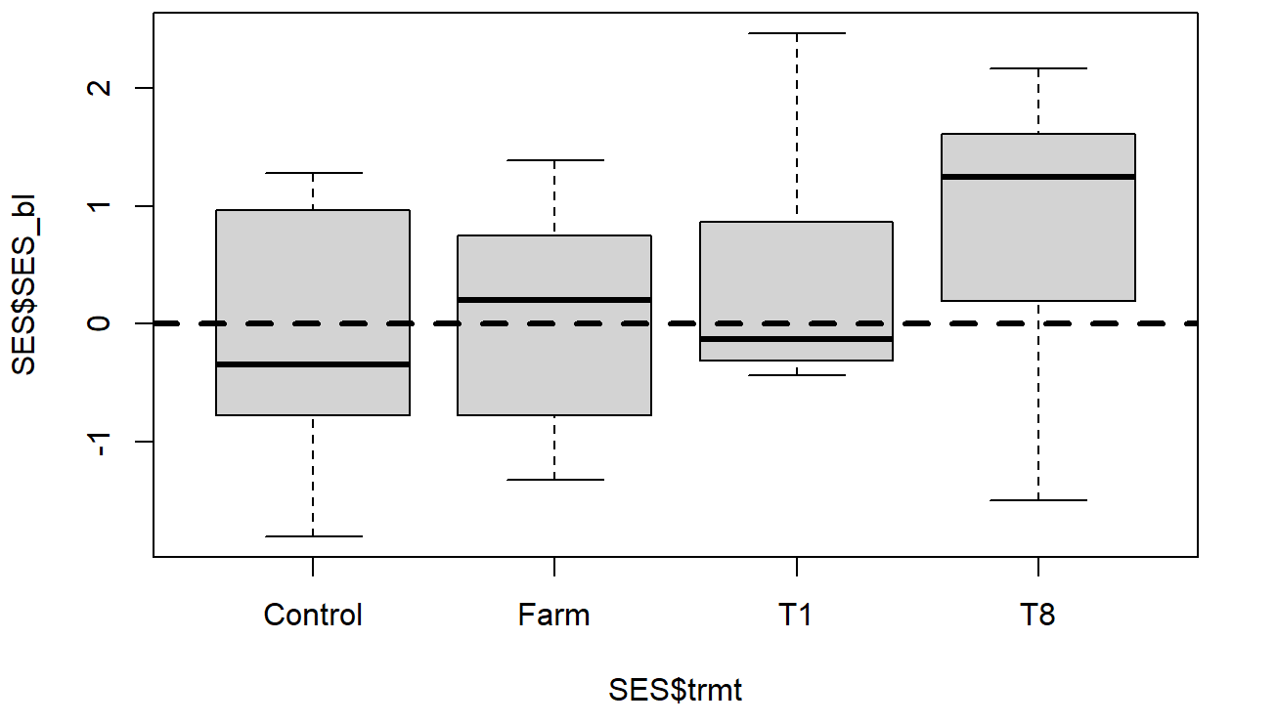
Body lengths vs Null

Slide 5
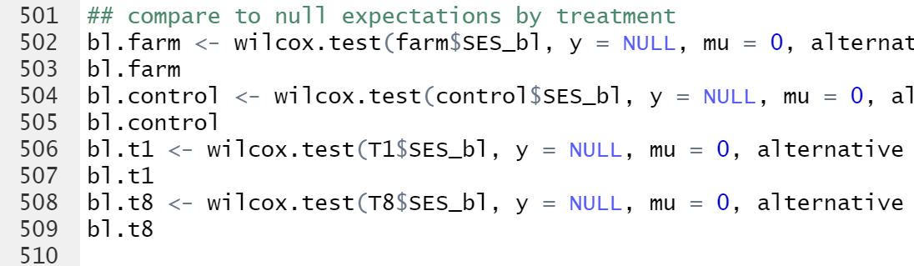
Was it enough to just separate Francis and Katie’s control/T1s?
Or
Or do I need to change the way I run the nulls somehow?

